Slide 1
ICICV 2020 • Springer • Manipal University Jaipur
Attribute-Based
Break-Glass Access Control
Framework for Medical Emergencies
Paper presented by Anubha Parashar
School of Computing & Information Technology

Slide 2
Why this work matters
IoT healthcare needs fast access and strong protection at the same time.
Wearable sensors and medical devices collect patient data continuously.
Cloud infrastructure enables doctors to review EHR data and support remote care.
Security failures in healthcare can expose sensitive data or delay treatment.
Patient
Sensor
Cloud
Doctor
Connected care pipeline
Core tension
Routine access requires strict authentication; emergency care requires immediate access.
ICICV 2020 • Attribute-Based Break-Glass Access Control • 2

Slide 3
The emergency access challenge
Normal security policies are essential — but in emergencies, they can become a bottleneck.
Normal access
Emergency break-glass
User
Policy
Data
ESH
ESK
EHR
Attribute-based checks enforce who can decrypt and access sensitive data.
Emergency Situation Handlers need controlled bypass after verification and false-alarm screening.
Design goal: reduce delay without removing accountability.
ICICV 2020 • Attribute-Based Break-Glass Access Control • 3

Slide 4
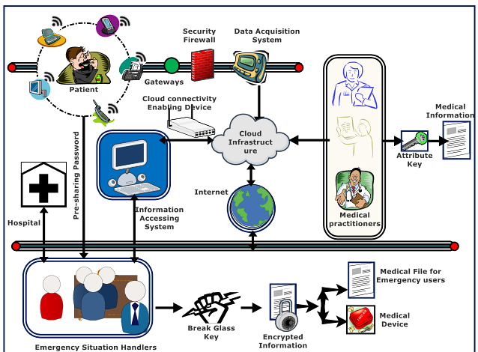
Proposed framework architecture
Four cooperating actors create normal and emergency access pathways.
Medical Service Provider manages healthcare resources and devices.
Cloud Infrastructure stores encrypted medical information.
Medical Service Consumer receives care through IoT-enabled monitoring.
Emergency Situation Handler can access data/device only in verified emergency mode.
Key idea: normal attribute access + controlled break-glass access in one lightweight scheme.
ICICV 2020 • Attribute-Based Break-Glass Access Control • 4

Slide 5
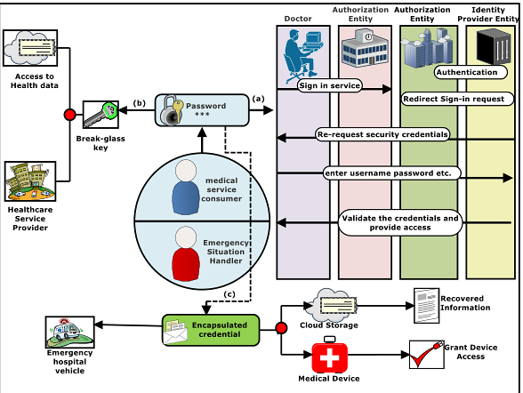
Emergency key extraction workflow
The workflow verifies the handler, creates an Emergency Session Key, and grants bounded access.
1 Verify ESH credentials
2 Build emergency session key
3 Screen false alarms
4 Decrypt EHR + device access
ICICV 2020 • Attribute-Based Break-Glass Access Control • 5

Slide 6
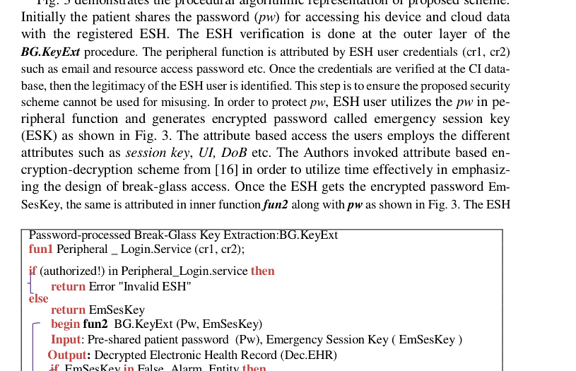
Algorithm at a glance
BG.KeyExt keeps the emergency pathway controlled: authenticate first, then decrypt.
Input
ESH credentials + patient password
Validate
Reject invalid handler
Check
Stop if false emergency
Authorize
Load role and ESH policies
Output
Break-glass key and access rights
ICICV 2020 • Attribute-Based Break-Glass Access Control • 6

Slide 7
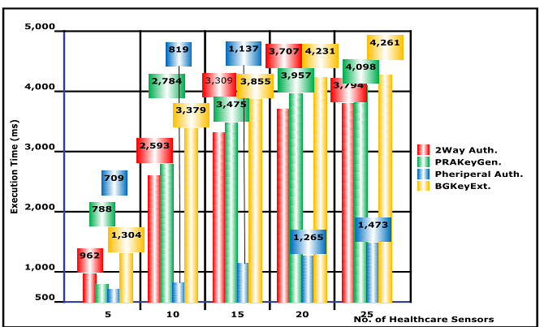
Result analysis: computational cost
Execution-time comparison across increasing numbers of healthcare sensors.
Observed trend
Multilayer authentication grows slower under low resource counts but scales poorly as sensors increase.
Key efficiency point
The proposed scheme is presented as lightweight, with minimal calculations at device and storage levels.
Practical impact
Lower latency supports emergency handling in resource-constrained IoT healthcare settings.
ICICV 2020 • Attribute-Based Break-Glass Access Control • 7

Slide 8
Security contribution
The design balances availability, authorization, and confidentiality.
2
1
False-alarm guard
3
Emergency access is refused when the event is flagged as false.
Verified handler
Encrypted EHR
Credentials are checked before emergency access begins.
Model argues resistance under DBDH-based security assumptions.
Contribution: a lightweight access-control path that handles normal data decryption and verified emergency override.
ICICV 2020 • Attribute-Based Break-Glass Access Control • 8

Slide 9

Takeaways
1
Medical emergencies need availability, not just confidentiality.
2
Break-glass access must be verified, policy-bound, and auditable.
3
The proposed framework targets fast, lightweight emergency access for IoT healthcare.
Presented at ICICV-2020 • Manipal University Jaipur • Springer
Paper: “An Attribute Based Break-Glass Access Control Framework for Medical Emergencies”

